Slide 1

First Steps Analysis Document
Jump the Queue V1.1

Slide 2


Statement of Purpose
Project Introduction
Existing systems that manage queues and turns consists only in the assignation of a number without any associated logic that improves user experience and give value to user and to queue owner.
Classic systems do not allow to know at what time will be each turn. In addition, clients only can consult queue status if he stay at the queue location. This provoke a bad user experience because he must to stay in the queue all waiting time. Besides, in an amount of cases, this causes that some users leave the queue because of the long waiting time, provoking the lost of the sales.
Ideally the users of the queue have to be able to know at what hour could be its turn. It is very important because they can improve their time and they will need to wait in the queue and only go when its time comes. Besides, to facilitate that the user has not to be in the queue waiting its turn, he can consult the queue status at any device that he can have. (for example a mobile phone, tablet, ..)
As value added, queue owners will be able to prioritize users at the queue to have the possibility of create marketing campaigns.
A successful solution would be to improve user experience facilitating that the user has not to be in the queue waiting its turn.

Slide 3
Objectives & Requirements
Requirements
Support inscription process, validating contact information.
The objectives of the project are:
Eliminate the needed of stay waiting in a queue.
Improve user experience, easing the access to the queue.
The system has to be simple and easily scalable and extensible
Possibility of consult status of the queue, showing the list of persons in the queue.
Support term & conditions acceptation process.
Queue system has to be accesible by several platforms types (mobile, computer, ..)
Support queue prioritizations. Users of queue owner system will be first in the queue

Slide 4
Glossary of Terms
Queue
Estimated time
Place where people stay until they are attended
Stands for the time that the system calculates when the person in the queue will be attended
Access code
Attention time
This is the turn number assigned to a person
This is the time that it takes for a user to be attended. It is calculated as the difference between the start and the end of the attention
Validation code
Priority access
It is a code used to confirm the validity of the email or telephone number informed by the user
It is the access granted to privileged users so they can be attended earlier

Slide 5
Actors
User / Visitor
Jump the Queue user that does not exists in the owner system and wants to get access to a queue.
User / VIP
Internal user of the owner system that has privilege access to a queue.
Owner
Owner of a business and client of Jump the Queue. He will create and manage queues.

Slide 6


User Story Map
USER STORIES
USER STORIES
USER STORIES
Get a Number
Consult the Queue
Manage the Queue
EPICS
Accept Terms & Conditions
Consult Queue
Configure Queue
Verify Information
Waiting Time
Attend Queue
Consent Information
Register
Priority Access

Slide 7

Step 1 Get a Number
At this step, the user gets a number to enter in the queue.
Jump the queue must support at this point:
Acceptation of terms & conditions.
Validation of personal information.
Priority numbers.
Obtain a ticket number
© 2017 Capgemini. All rights reserved.

Slide 8
User Story 1
Accept terms & conditions
I need
to accept terms and conditions
So that
I can access jump the queue system
Acceptance Criteria:
- Terms and conditions will be configurable and the system must show this text.
- The system will ask to accept terms and conditions before getting an access code.
User /Visitor
Priority:Medium
Size:
Dependency:
© 2017 Capgemini. All rights reserved.

Slide 9
User Story 2
Verify information
I need
my telephone number or email to be verified
So that
their validity will be confirmed
Acceptance Criteria:
- User has to receive and email or and SMS with a validation code.
- The system will only grant the access to users that input this validation code.
User /Visitor
Priority:
Size:
Dependency:
© 2017 Capgemini. All rights reserved.

Slide 10
User Story 3
Consent information
I want to
give my permission for the use of my personal information
So that
I can received commercial notices
Acceptance Criteria:
- This functionality can be activated or de-activated.
- If the user gives its permission, the system must save this information.
User /Visitor
Priority:
Size:
Dependency:
© 2017 Capgemini. All rights reserved.

Slide 11
User Story 4
Register
I want
to register to obtain a access code for the queue
So that
I get an access code
Acceptance Criteria:
- User can inform a phone, email and a Name.
- The name is mandatory.
- The phone or the email have to be informed.
- The phone or the email have to be confirmed.
- The access code will be formatting as "Q" plus a number between 0 to 999.
- The access code will be the next free number. If the number reaches 999, the number continues with 0.
- The email, phone cannot be repeated in more than one non attended turns.
User /Visitor
Priority:
Size:
Dependency:
© 2017 Capgemini. All rights reserved.

Slide 12
User Story 5
Priority Access
I want
to get priority access code to the queue
So that
I will be attended earlier
Acceptance Criteria:
- The access code will be formatted as "A" plus a number between 0 to 999.
- The access code will be the next free number. If the number reaches 999, the number continues with 0.
User /VIP
Priority:
Size:
Dependency:
© 2017 Capgemini. All rights reserved.

Slide 13

Step 2 Consult the Queue
It contains all functions that permit consult the status of the queue.
It must support at this point:
Show people in the queue and their turn.
Show attention estimated time (when a person will be atended)
© 2017 Capgemini. All rights reserved.

Slide 14
User Story 6
Consult Queue
I want
to consult the status of the queue
So that
I would know when it is my turn
Acceptance Criteria:
- The system only returns the non-attended turns of the queue.
- The list will be ordered by the time when the ticket was taken, except in the case that the access code will be of the form "A" + number that will be first (priority access).
-The list must return the following information: Access code, estimated time and Name.
- The user can consult the status of the queue although he has left of the system.
User/Visitor
User/VIP
Owner
Priority:
Size:
Dependency: US 4
© 2017 Capgemini. All rights reserved.

Slide 15
User Story 7
Waiting time
I want
to see my estimated waiting time
So that
I would know when I will be attended
Acceptance Criteria:
- The system has to calculate the estimated time with the following formula: current hour + (Sum(The last ten attention time)/nº of attended turn counted)*(number of non-attended turns in the queue before this).
The number cannot be less than a configurable value
The attention time is the difference between the start time and the end time
User/Visitor
User/VIP
Priority:
Size:
Dependency: US 6
© 2017 Capgemini. All rights reserved.

Slide 16

Step 3 Manage Queue
It contains all functions that allow to manage the queue in order to configure and attend active turn.
© 2017 Capgemini. All rights reserved.

Slide 17
User Story 8
Configure queue
I need
to personalize the logo and description of the queue showed to users
So that
I can personalize my business
Acceptance Criteria:
- The system allows to configure a logo and description.
- Jump the queue front shows the logo and description
Owner
Priority:
Size:
Dependency:
© 2017 Capgemini. All rights reserved.

Slide 18
User Story 9
Attend queue
I need
to know the current turn of the queue
So that
I can attend it
Acceptance Criteria:
- The turn has to be the first in the queue that is non-attended.
- The system must save:
- At the previous turn: Save the current time as end time
- At the new turn: Save the current time as start time
Owner
Priority:
Size:
Dependency: US 4
© 2017 Capgemini. All rights reserved.

Slide 19
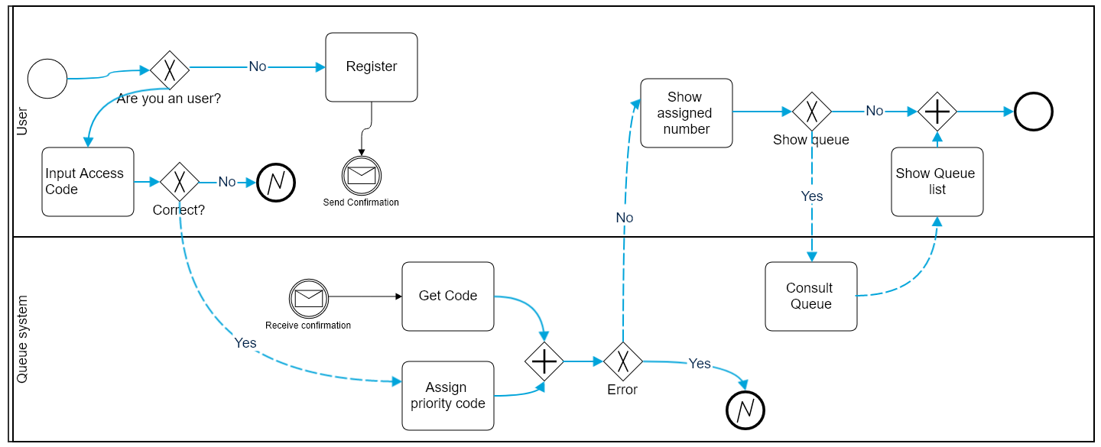
Business Process Map

Slide 20
Select Queue (owners website) / Write URL
Request
/Insert Code
Terms &
Conditions
Sitemap
Assigned Order /
Show queue
Screens & Initial structure

Slide 21
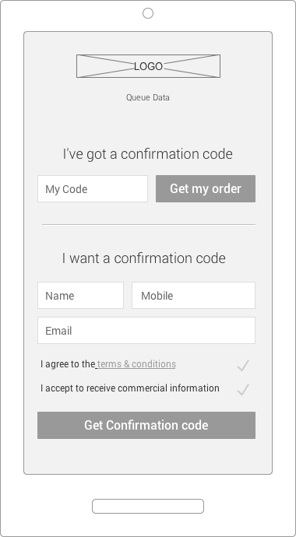
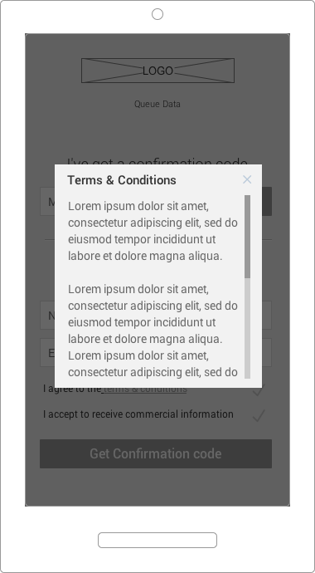
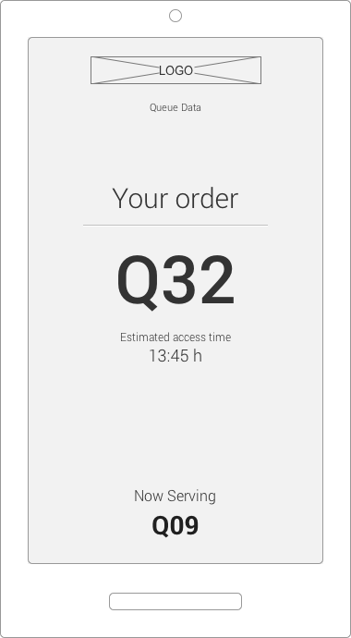
Sketches User Screens
Select Queue (owners website) / Write URL
Terms &
Conditions
Request
/Insert Code
Assigned
Order / Show queue
Request/Insert code
Screen
Terms & Conditions
Popup
Assigned Order / Show queue
Screen

Slide 22
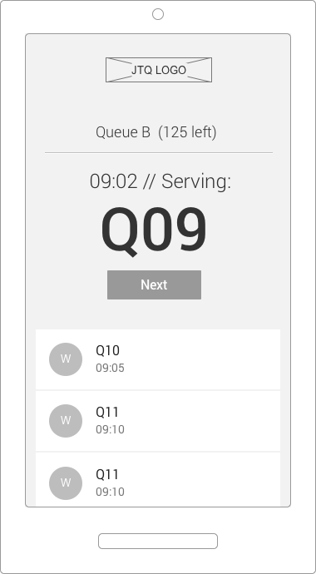

Sketches Owner Show/Serve Sample
Show/Serve Queue
Screen)
Serve Queue
(physical button)

Slide 23
Conclusions
We will follow an Agile methodology for the development of the solution in order to reduce the time of each delivery and assure the business needs.
This document covers the necessary aspects that the system must fulfill.
In the following analysis phase, we will detail all solution aspects.

Slide 24
Thanks for your attention

